Slide 1
DHT11 with IBM Watson Cloud Platform
Muhammad Teddy Rahmansyah
Natasya Salsabilla

Slide 2
TABLE OF CONTENTS
01
02
Schematic Design
Sketch Code
03
04
IBM Cloud
Testing the Cloud

Slide 3
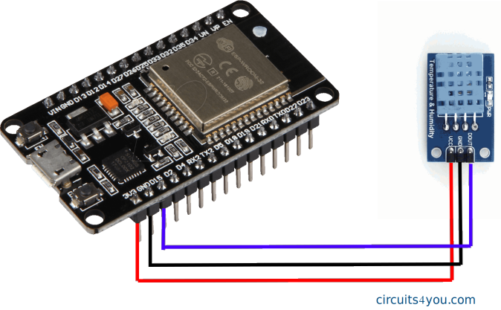
Schematic Design

Slide 4
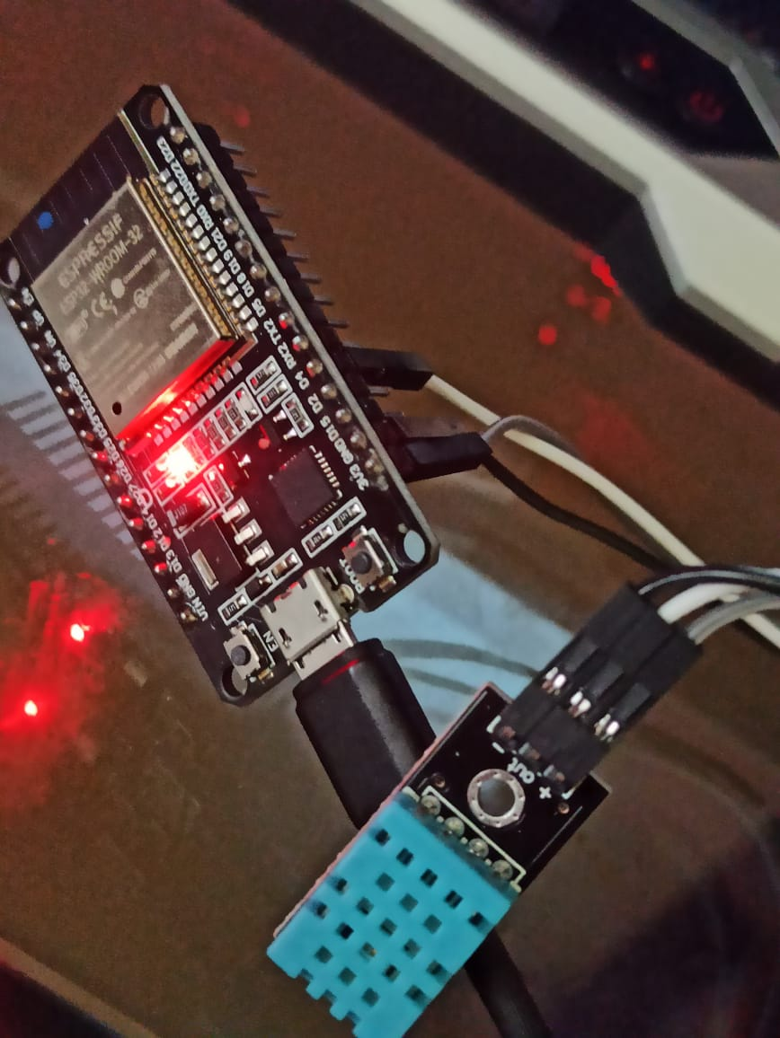

Slide 5
Sketch Code
Link in Description Box

Slide 6
Setting Up IBM Cloud Platform
Masuk ke Website https://cloud.ibm.com/
dan Login/SignUp.

Slide 7
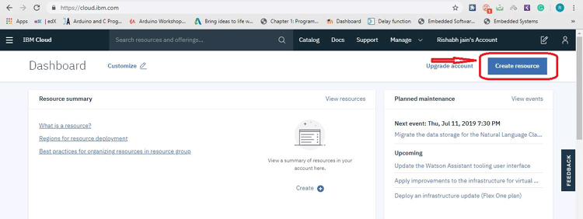
Create Resource

Slide 8
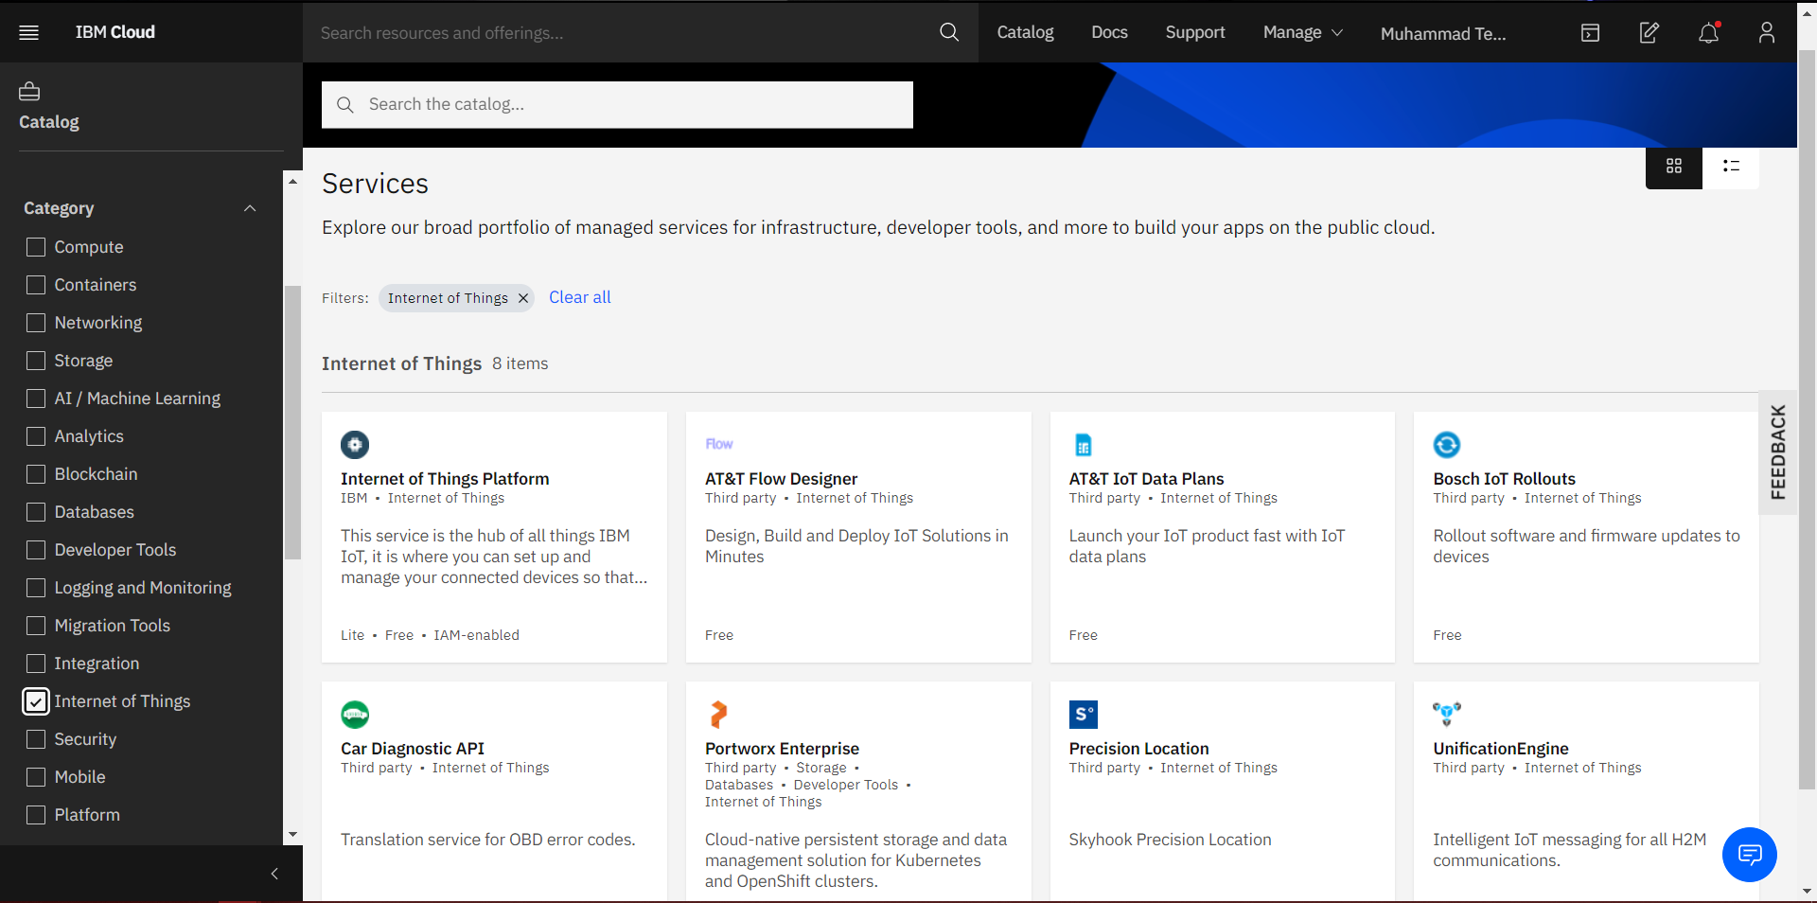
Choose Service (Internet of Things Platform)

Slide 9
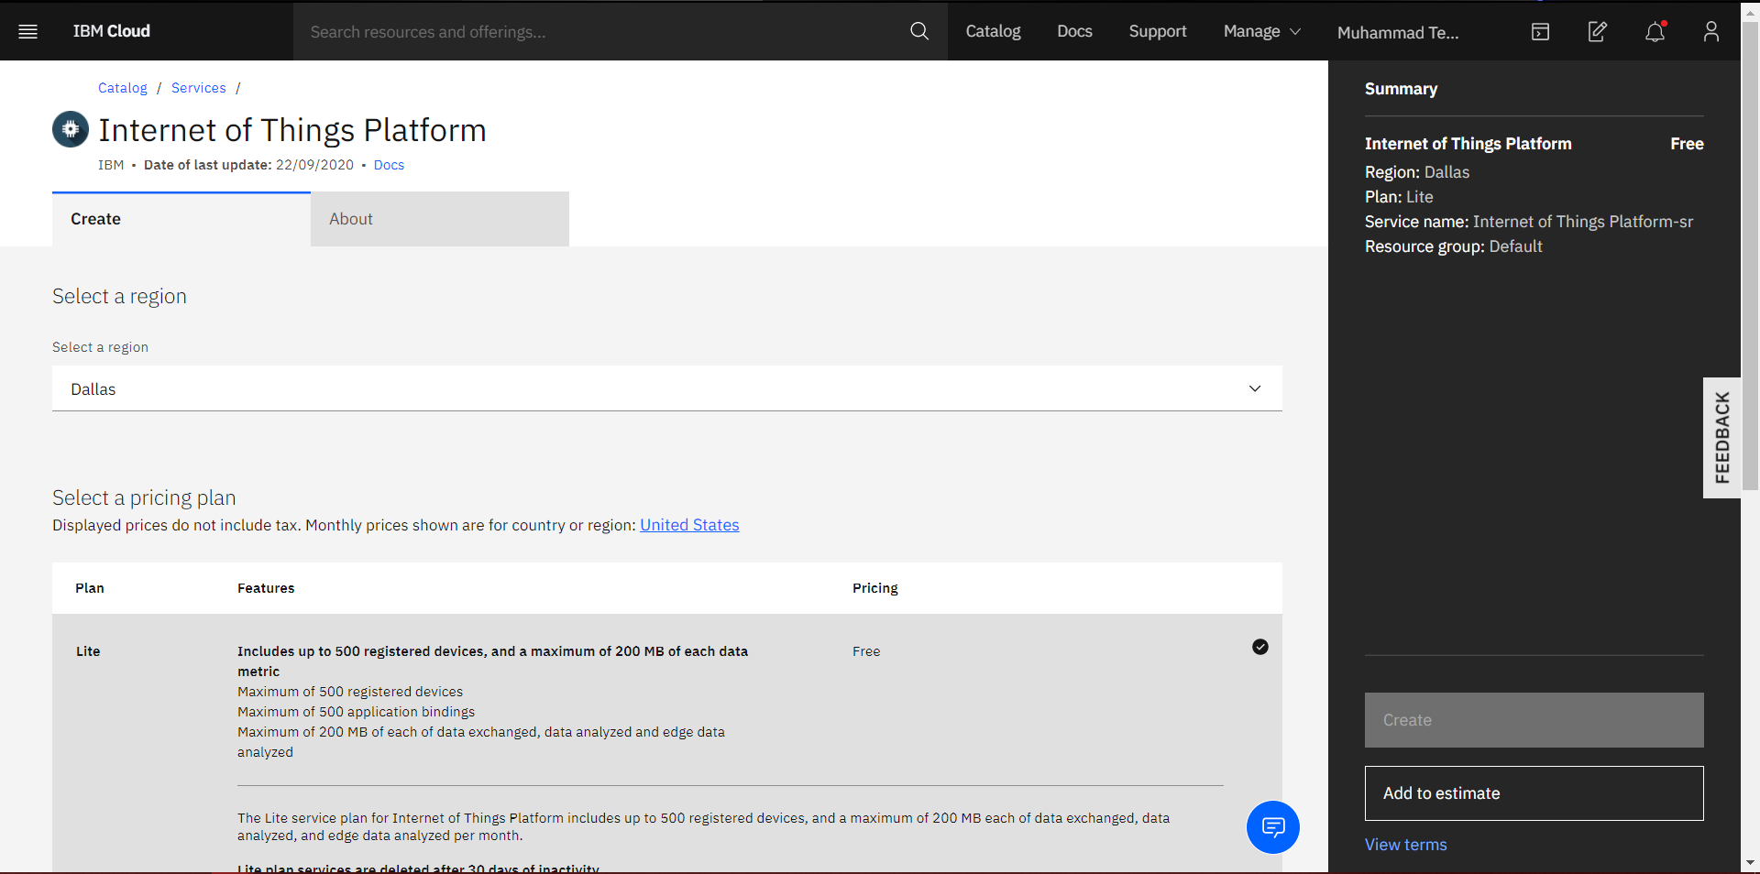
Create Service (Internet of Things Platform)

Slide 10
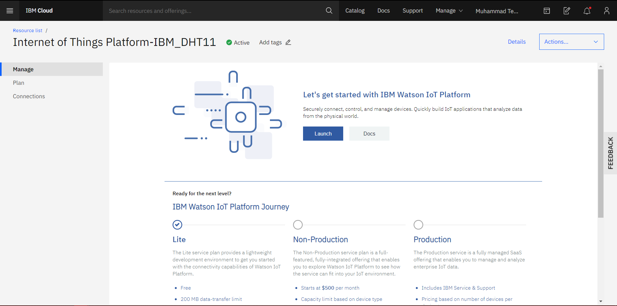
Tampilan Awal Platform Service

Slide 11
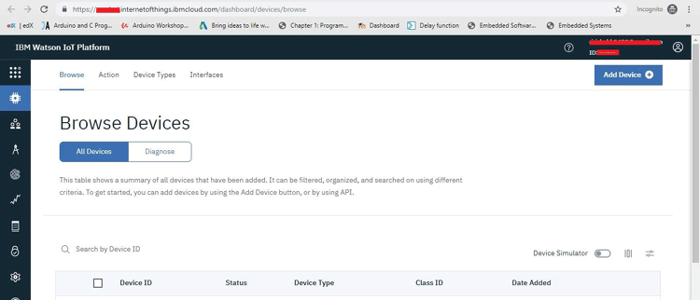
Add IoT Device

Slide 12
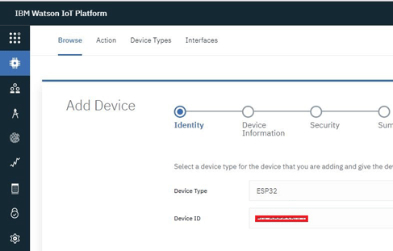
Add IoT Device
uint64_t chipid;
void setup() {
Serial.begin(115200);
}
void loop() {
chipid=ESP.getEfuseMac();
Serial.printf("ESP32 Chip ID = %04X",(uint16_t)(chipid>>32));
Serial.printf("%08X\n",(uint32_t)chipid)
delay(3000);
}
Kode untuk mendapatkan MAC Address
dari ESP32 yang digunakan

Slide 13
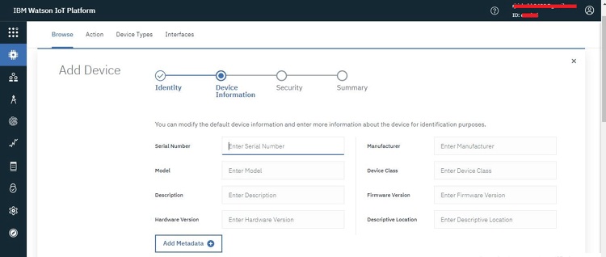
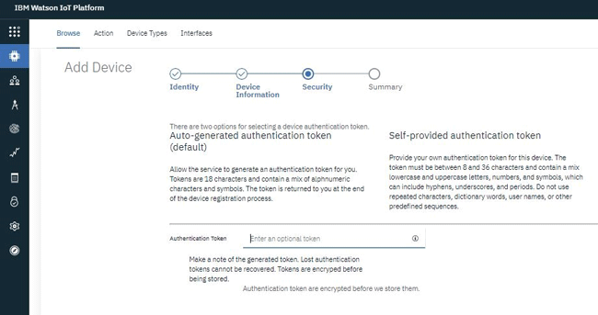
Device Information & Security

Slide 14
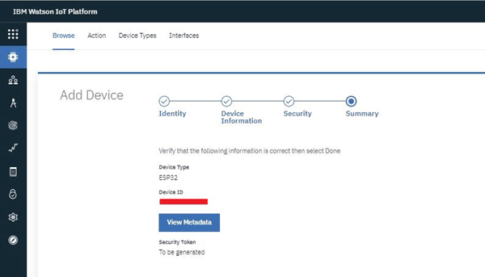
Summary

Slide 15
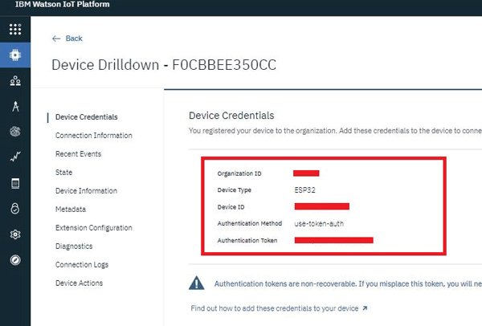
Device Credentials

Slide 16
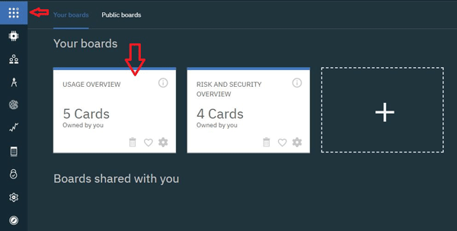
Boards

Slide 17
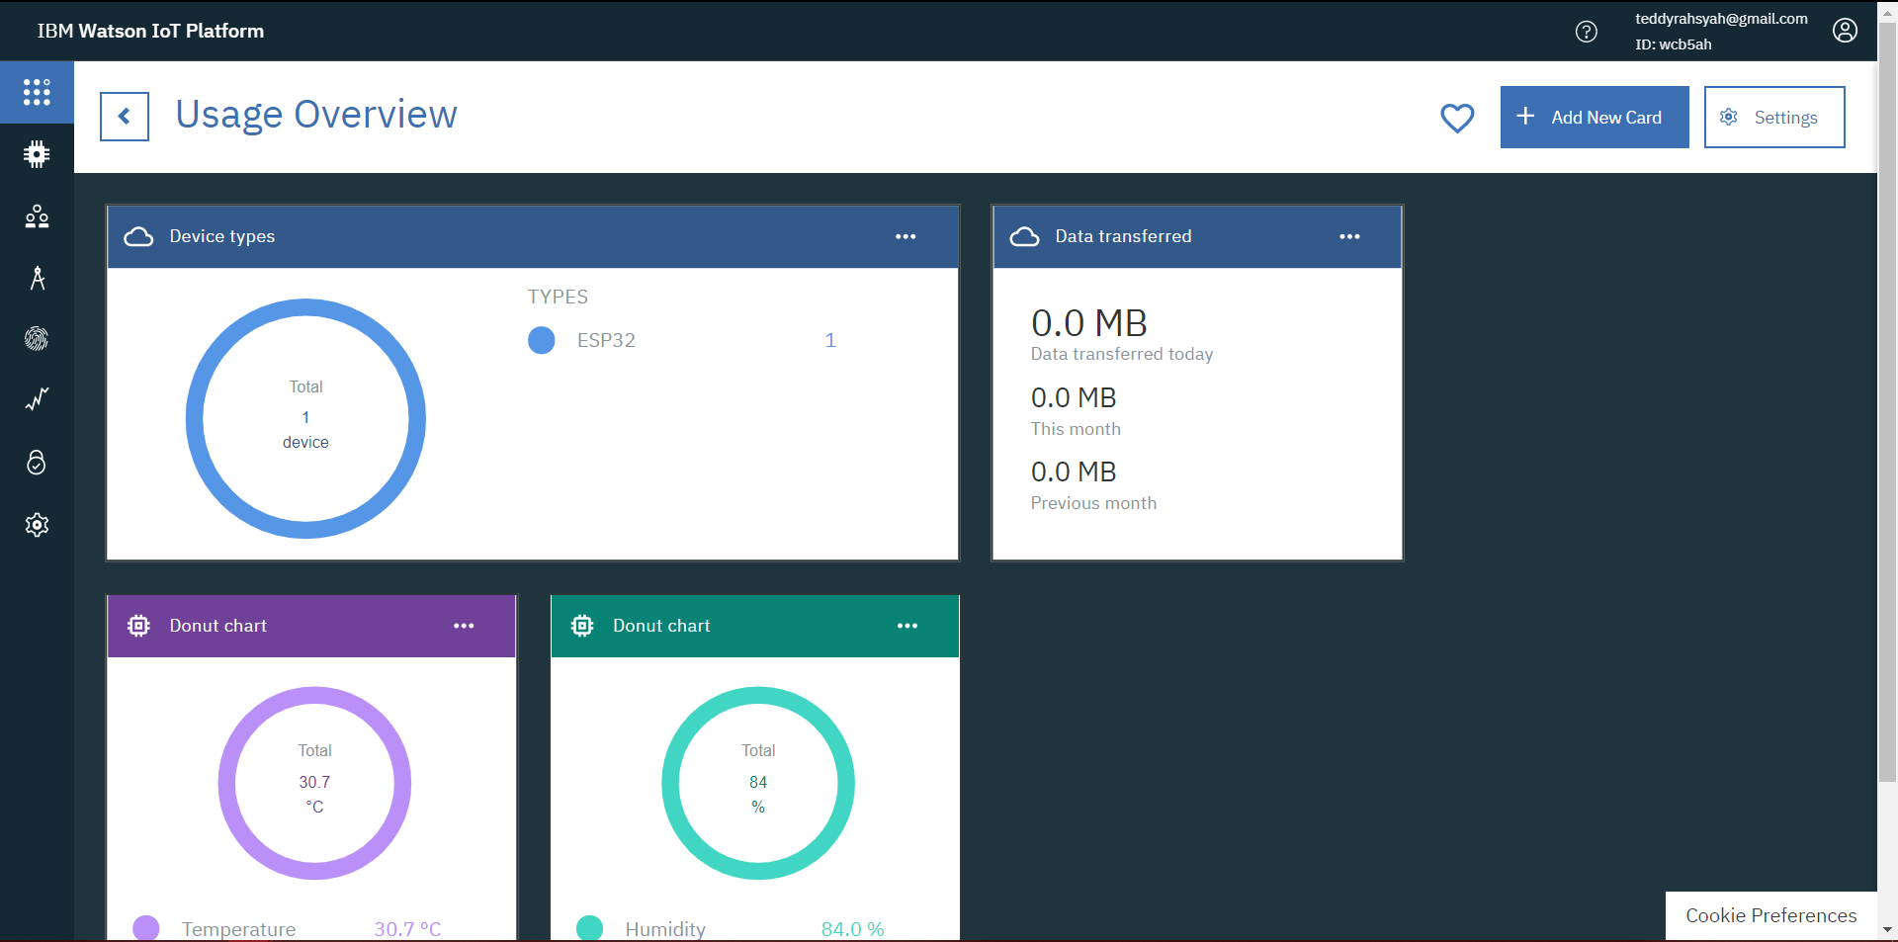
Usage Overview (Add New Card)

Slide 18
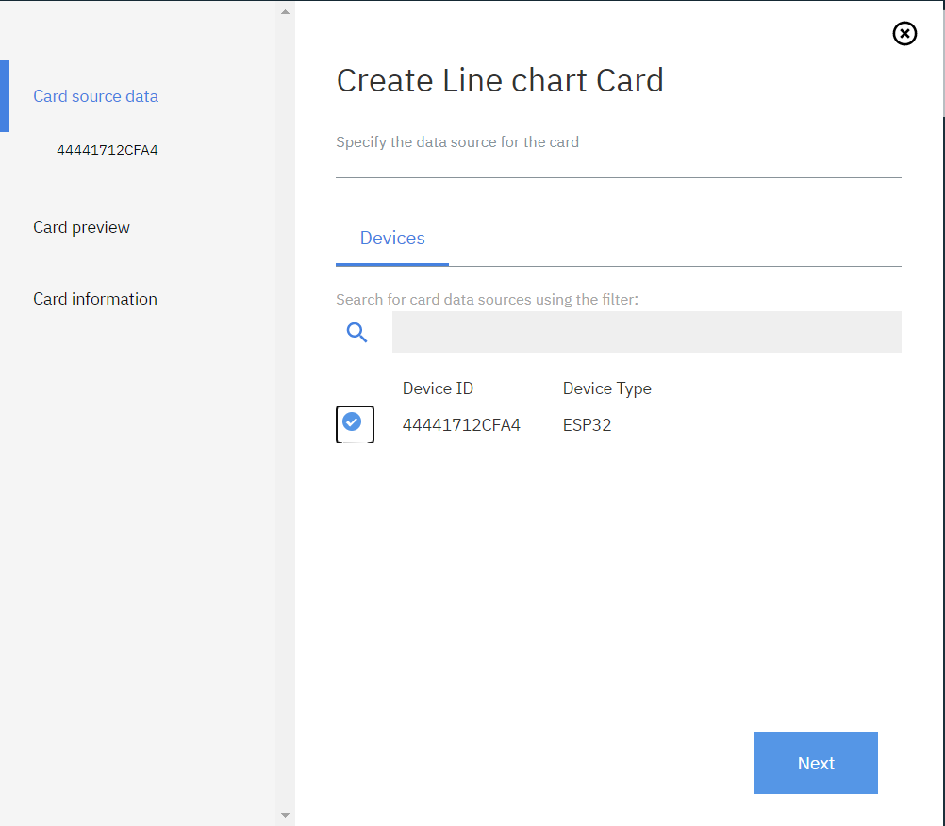
Usage Overview (Card Source Data)

Slide 19
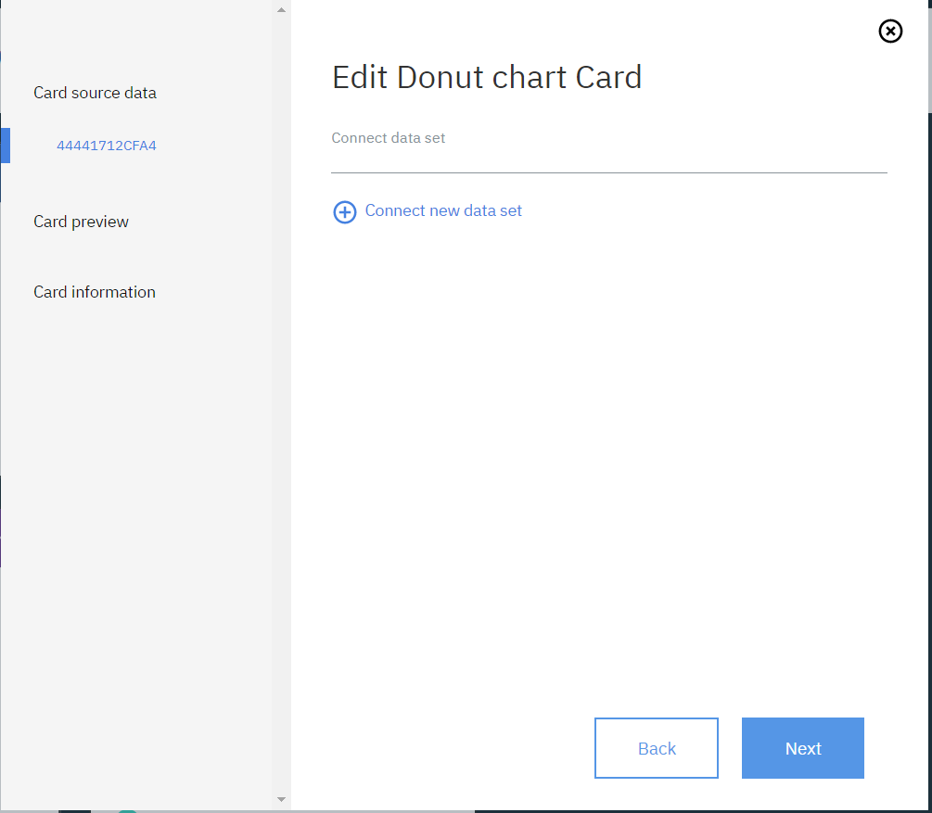
Usage Overview (Add New Data Set 1/2)

Slide 20
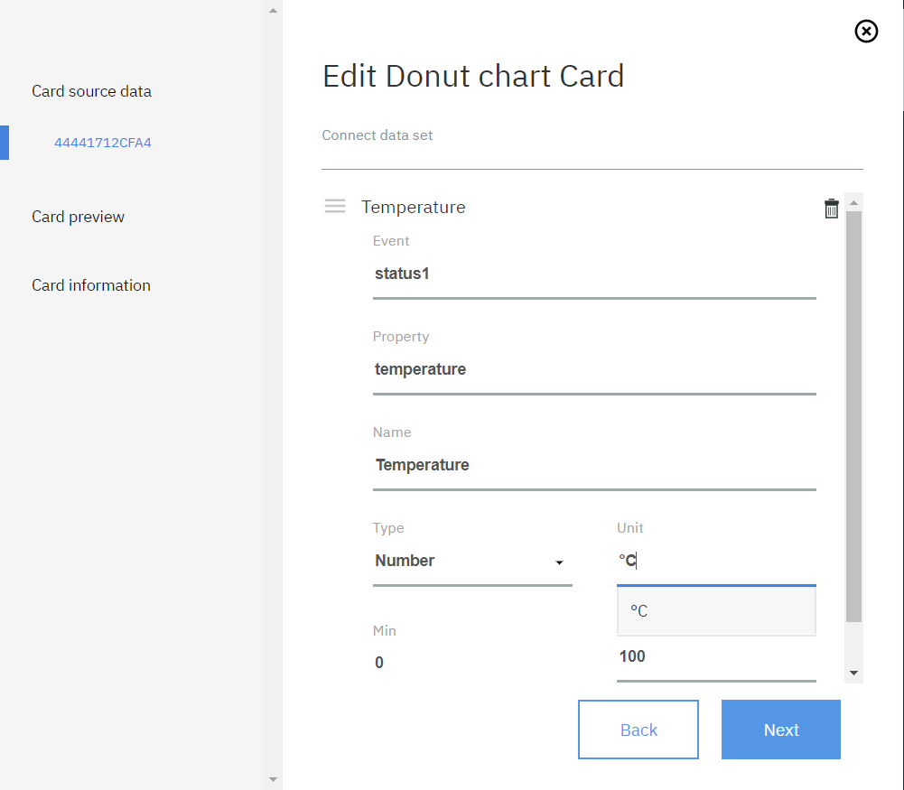
Usage Overview (Add New Data Set 2/2)

Slide 21
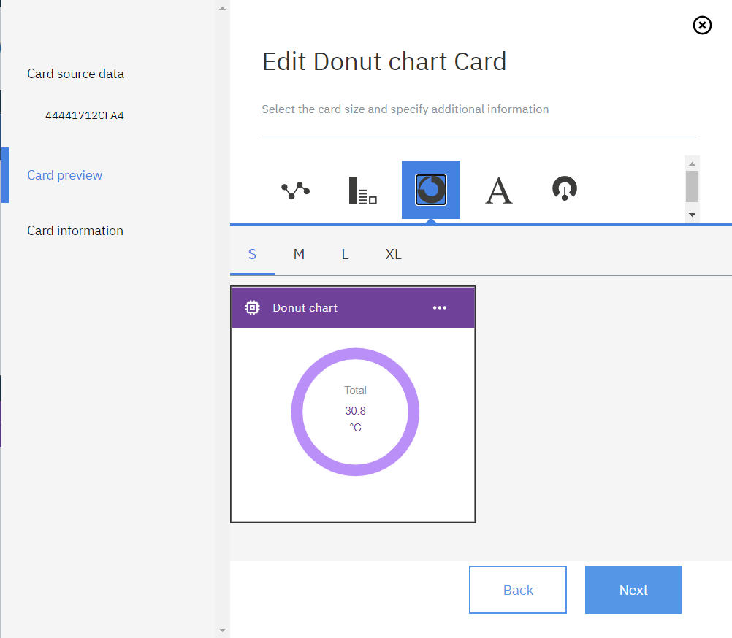
Usage Overview (Card Preview)

Slide 22
Usage Overview (Tampilan Awal)

Slide 23
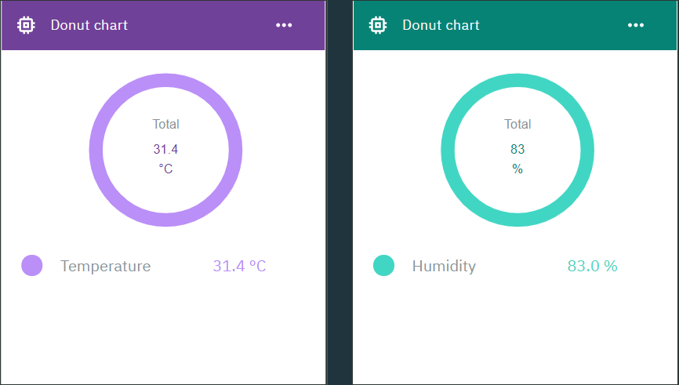
Testing the Cloud

Slide 24
THANKS

